Slide 1
DP FE Knowledge Sharing
Implement React18 from Scratch, but WASM
Regional Marketing Creative 2023

Slide 2
React WASM
Catalogue
React Workflow (First Rendering)
Webassembly and Rust Introduction
React WASM Introduction

Slide 3
React WASM
Catalogue
React Workflow (First Rendering)
Webassembly and Rust Introduction
React WASM Introduction

Slide 4
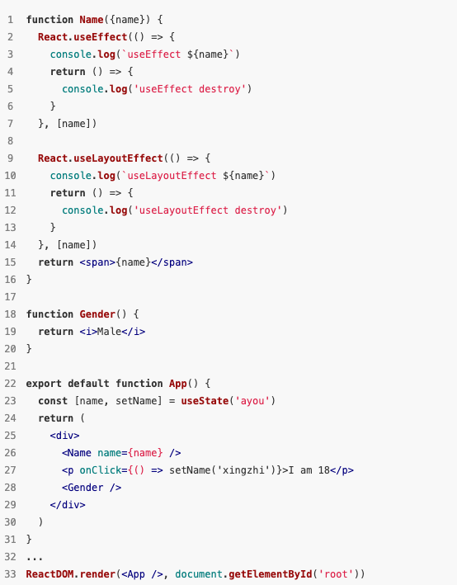
React WASM
React Workflow (First Rendering)
Preparation
Render
Commit

Slide 5
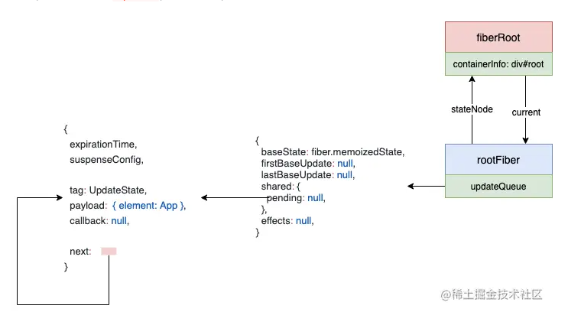
React WASM
React Workflow - Preparation

Slide 6
React WASM
React Workflow - Render
Objective: Build Fiber Tree & Collect Effects
beginWork
completeWork
Render Demo

Slide 7
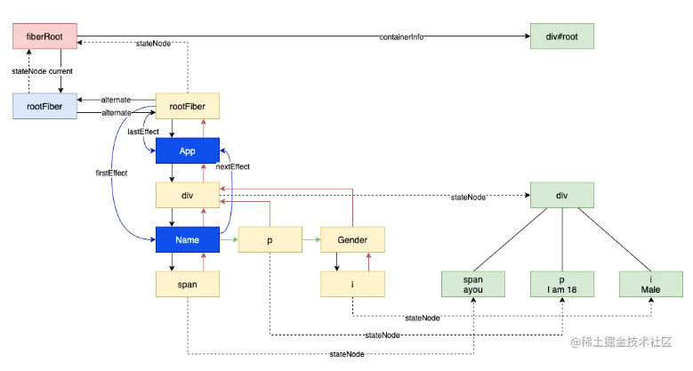
React WASM
React Workflow - Render

Slide 8
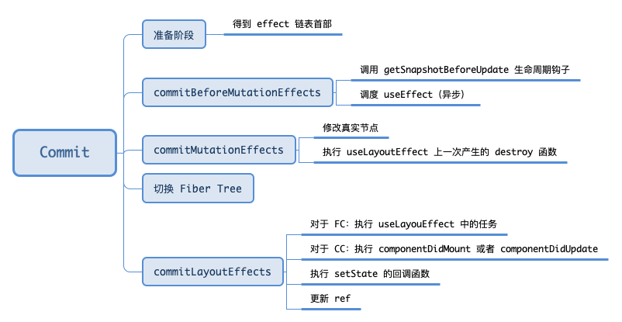
React WASM
React Workflow - Commit

Slide 9
React WASM
References
React技术揭秘
React 源码解读之首次渲染流程（含例子）

Slide 10
React WASM
Catalogue
React Workflow (First Rendering)
Webassembly and Rust Introduction
React WASM Introduction

Slide 11
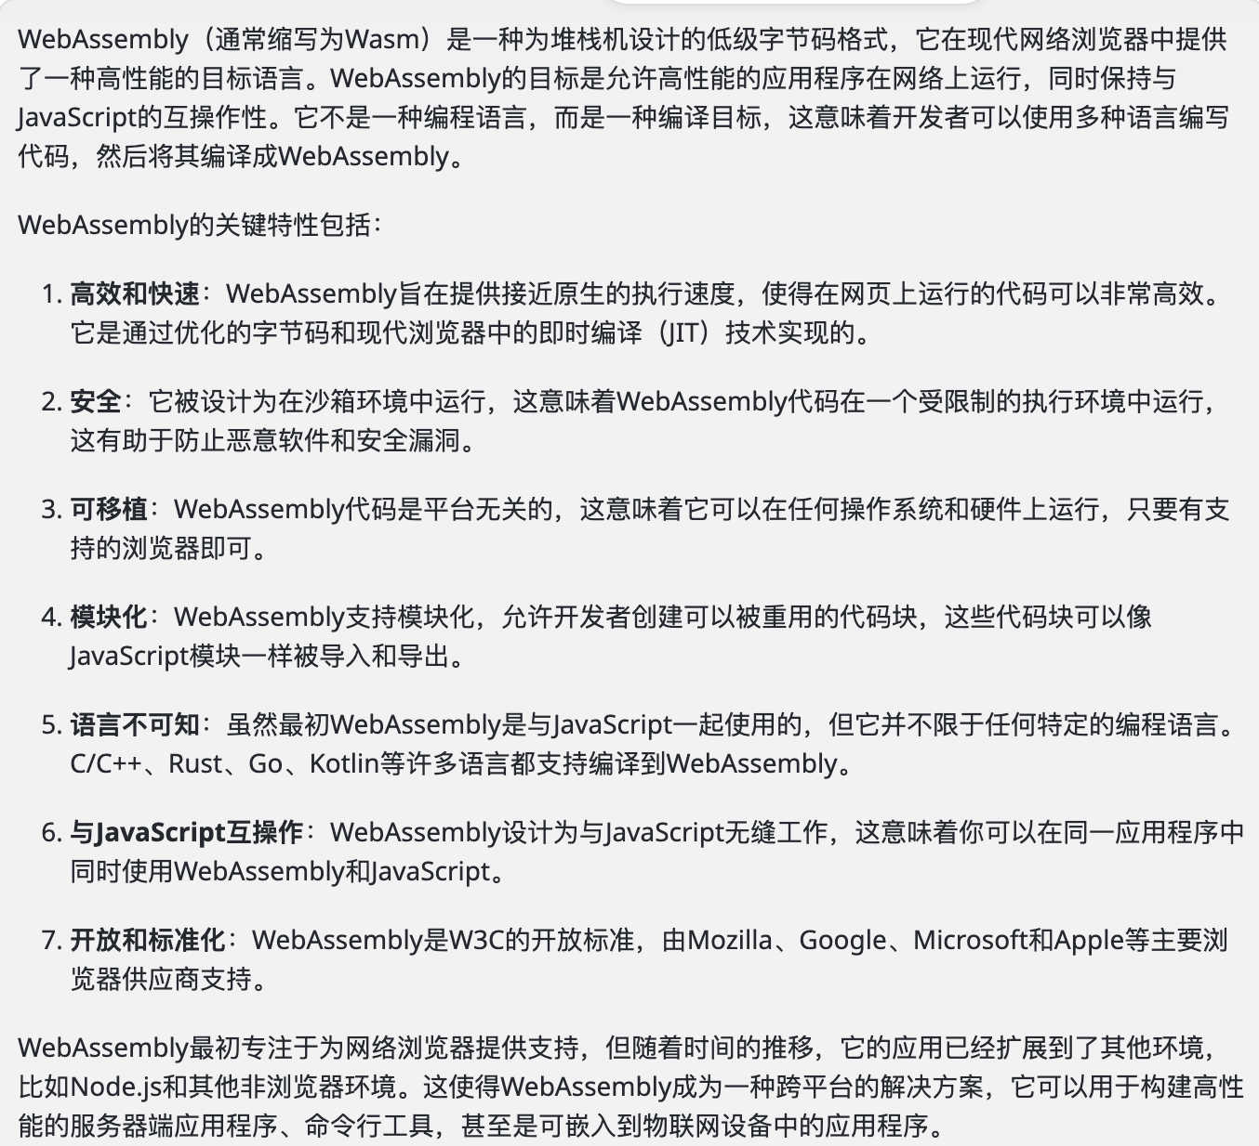
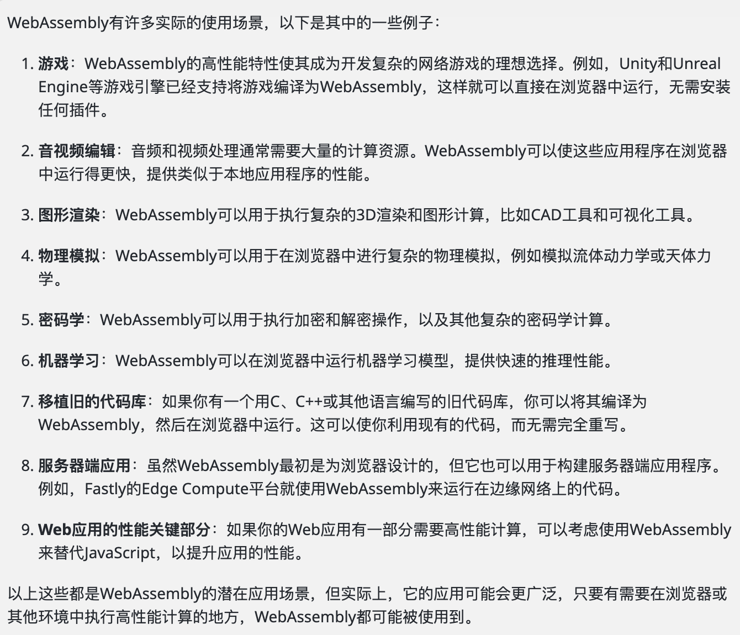
React WASM
Webassembly and Rust Introduction - Webassembly

Slide 12
React WASM
Webassembly and Rust Introduction - Webassembly
Eg: Rust WebAssembly 实现视频实时滤镜效果

Slide 13
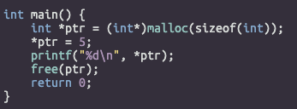
React WASM
Webassembly and Rust Introduction - Rust
Manage memory manually (C, C++)
Garbage Collection (JavaScript, Golang)
Forget to free -> Memory Leak
Use after free -> Crash or Safety Problem
Stop the World

Slide 14
React WASM
Webassembly and Rust Introduction - Rust
Auto memory management
No GC

Slide 15
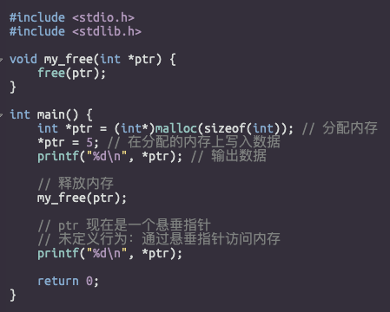
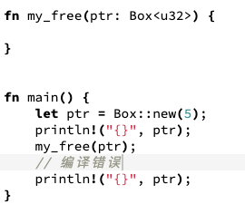
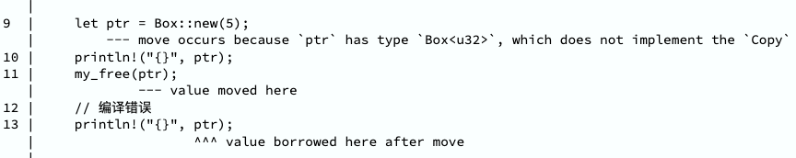
React WASM
Webassembly and Rust Introduction - Rust
Eg: Discover the dangling pointer problems in compilation stage by ownership mechanism

Slide 16
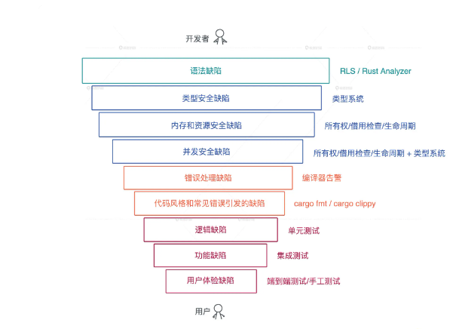
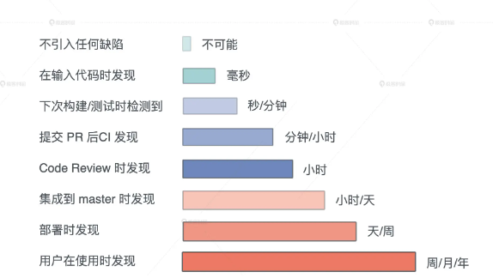
React WASM
Webassembly and Rust Introduction - Rust
Make problems be discovered earlier

Slide 17
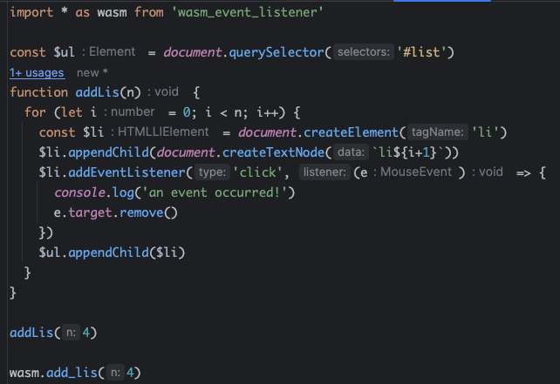
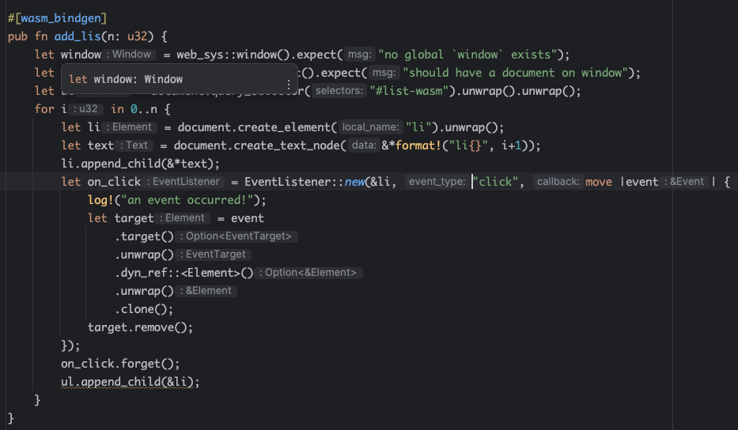
React WASM
Webassembly and Rust Introduction - Your First App
Demo1: Handling DOM

Slide 18
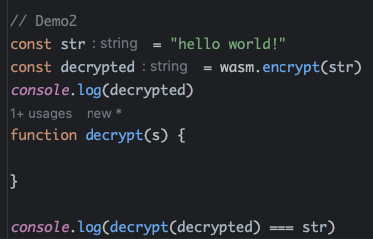
React WASM
Webassembly and Rust Introduction - Your First App
Demo2: Encrypt
WASM File
Can you implement the decrypt function according to WASM file?

Slide 19
React WASM
Catalogue
React Workflow (First Rendering)
Webassembly and Rust Introduction
React WASM Introduction

Slide 20
React WASM
How to implement React WASM?
Easy: Part 1 + Part 2
React WASM

Slide 21
Q & A
End
Regional Marketing Creative 2023

